Slide 1

v\Convolutional Neural Network for Movie Genre classification
Presented by : Ron Sider and Jordan Tangy

Slide 2
Steps of our presentation :
Introduction
1.1 What we want to achieve in our project
Our dataset and some examples
Implementation
3.1 Dealing with the dataset (Normalization, splitting,..)
3.2 Convolutional Neural Network Architecture
3.3 Training
3.4 Results (Model Accuracy and Model Loss)
3.5 Some examples of testing
4. Conclusion

Slide 3
1- Introduction
1.1 What we want to achieve in our project

Slide 4
Given a large data set of Movie Poster, we want to create a model that will be able to classify the model to its genre.
For such a task we downloaded a data Set from Kaggle which contains :
A file of 41K different movie posters
A csv file which contains all the metadata and the classification of the movies
We used only 30K images (lack of RAM)
We used the Google Colab platform to carry out this work.

Slide 5
2 - Our dataset and some examples

Slide 6
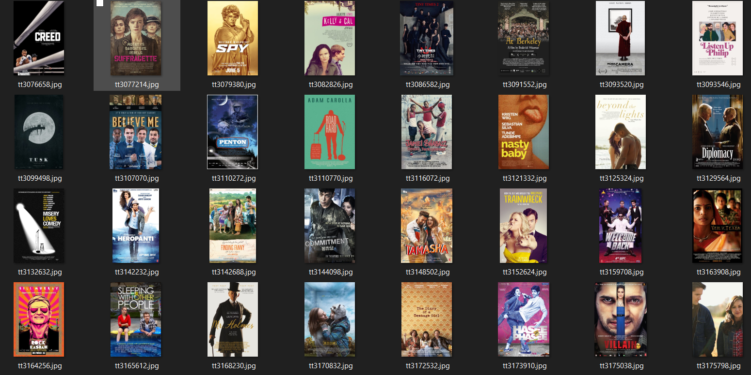
A sample from our images file

Slide 7
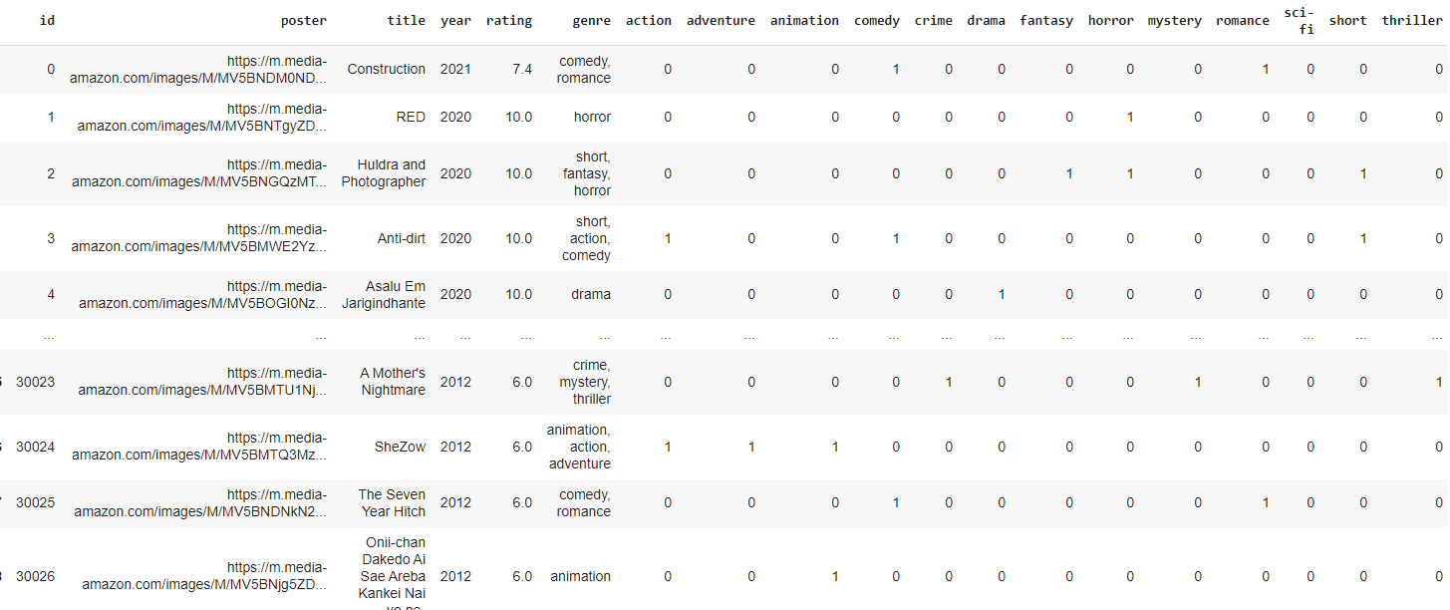
A sample from our csv file

Slide 8

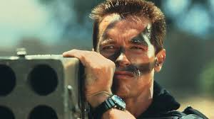

Genre Classification
CNN
CNN
Comedy,
Action
Action
CNN
Horror

Slide 9
General Steps
1. importing the data to environment(pandas)
2. Discarding irrelevant data.
3. Splitting the data to train and test sets.
4. deploying model of Convolutional Network.
5.Training the model.
6.deploying the results to test set.

Slide 10
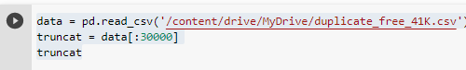
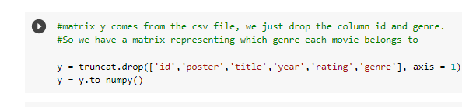
Data slicing(steps : 1,2,3)
30000 samples
Dropping irrelevant features

Slide 11
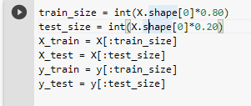
Train & Test set
Train set size = 30000*0.8 = 24000 training samples
Test set size = 30000*0.2 = 6000 test samples

Slide 12
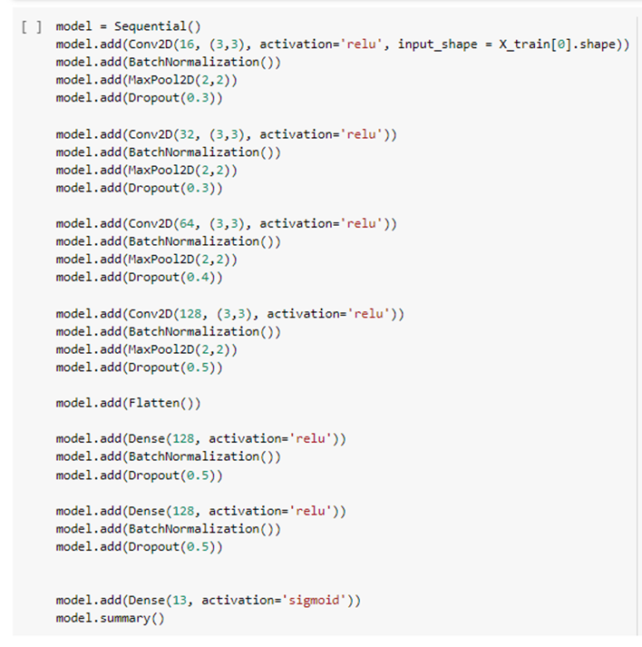
Convolutional Neural Network - model

Slide 13
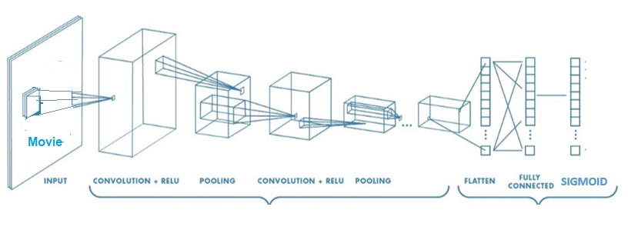



Model Visual Description
Action
Comedy
Horror
Sci Fi
.
.
.
4 Convolutional Layers. Sigmoid serves as an activation layer.

Slide 14
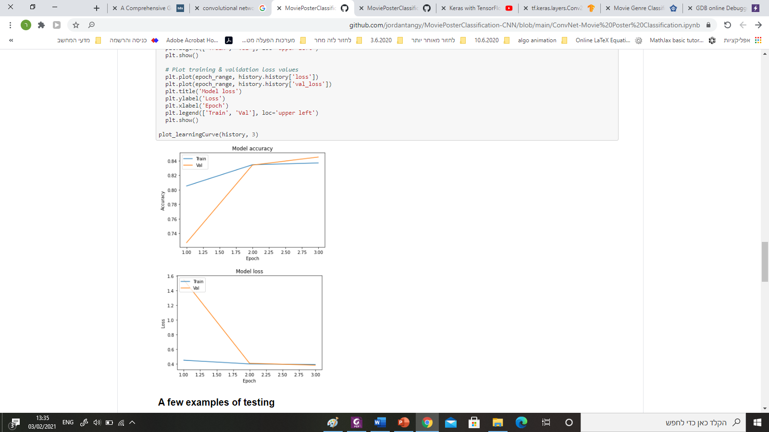
Results

